Slide 1

The Padding in TensorFlow
Notes:
1

Slide 2
Objectives
Overview of Padding in TensorFlow
Implement Padding in TensorFlow
The Padding in TensorFlow
2

Slide 3
Overview
Paddings is an integer tensor with shape [n, 2], where n is the rank of tensor. For each dimension D of input, paddings[D, 0] indicates how many values to add before the contents of tensor in that dimension, and paddings[D, 1] indicates how many values to add after the contents of tensor in that dimension.
If mode is "REFLECT" then both paddings[D, 0] and paddings[D, 1] must be no greater than tensor.dim_size(D) - 1.
If mode is "SYMMETRIC" then both paddings[D, 0] and paddings[D, 1] must be no greater than tensor.dim_size(D).
The Padding in TensorFlow
3
Notes:
3

Slide 4
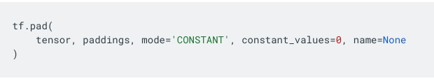
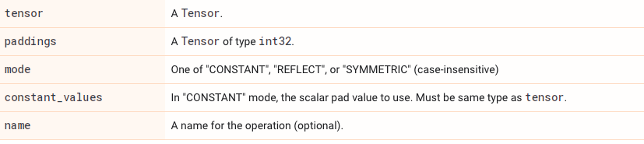
Overview
Syntax
Args
The Padding in TensorFlow
4
Notes:
4

Slide 5
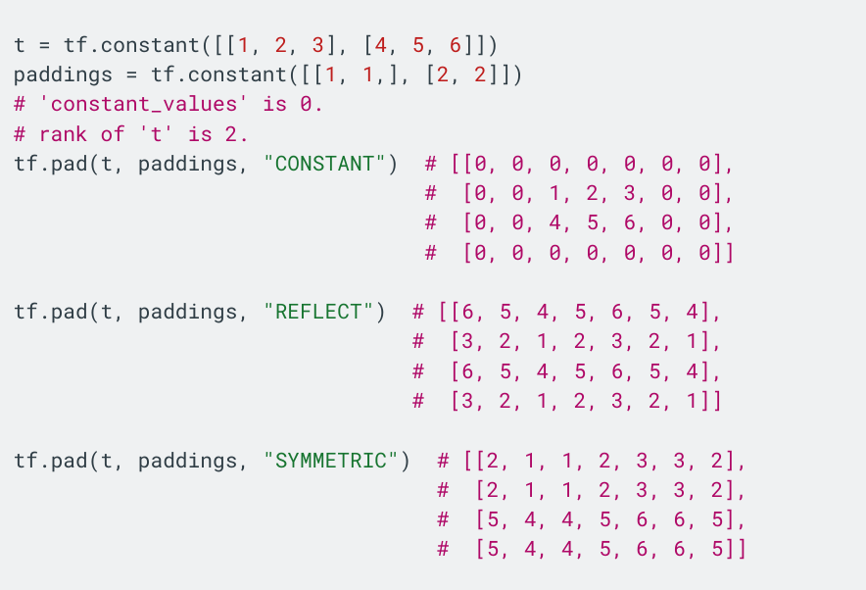
Overview
Example
The Padding in TensorFlow
5
Notes:
5

Slide 6
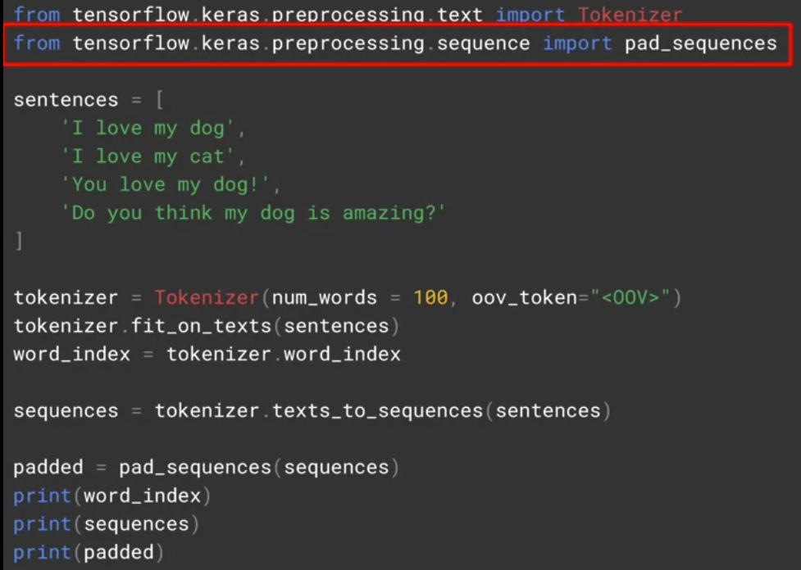
Padding in TensorFlow
Import pad sequences from tensorflow.keras.preprocessing.Sequence
The Padding in TensorFlow
6
Notes:
6

Slide 7
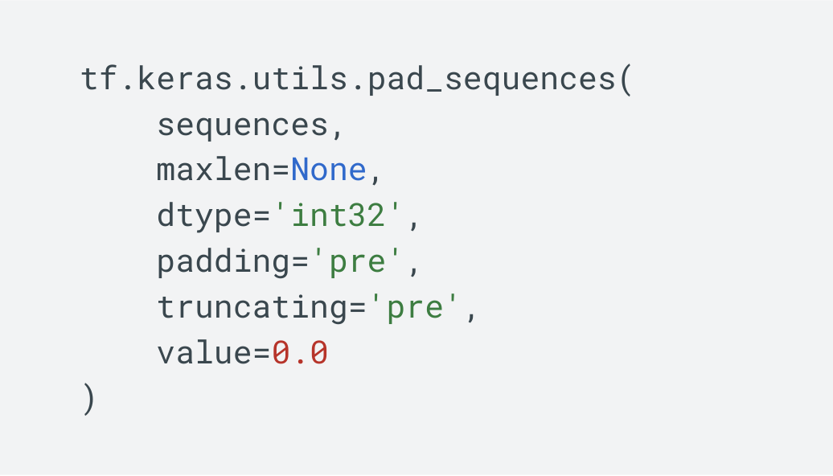
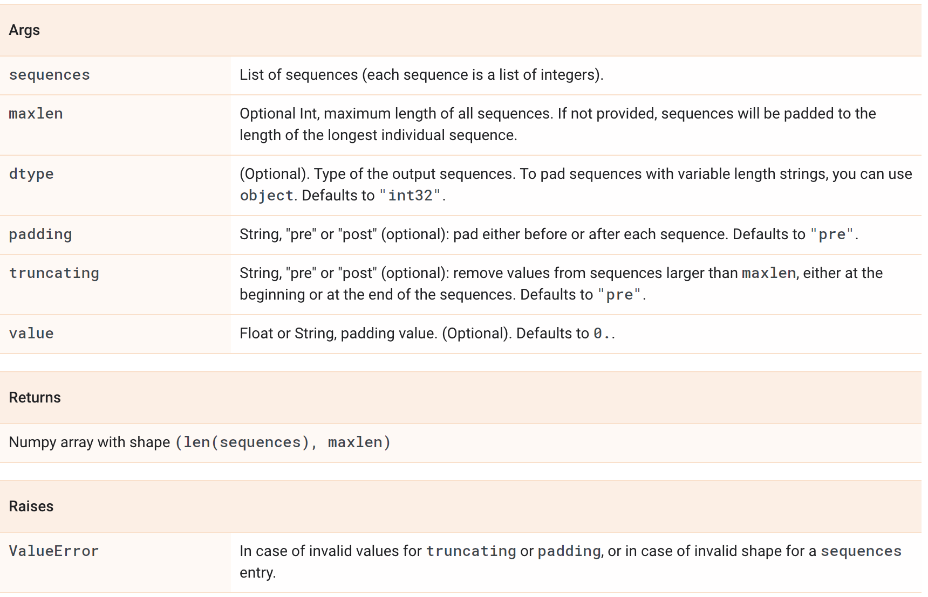
Padding in TensorFlow
tf.keras.utils.pad_sequences
The Padding in TensorFlow
7
Notes:
7

Slide 8
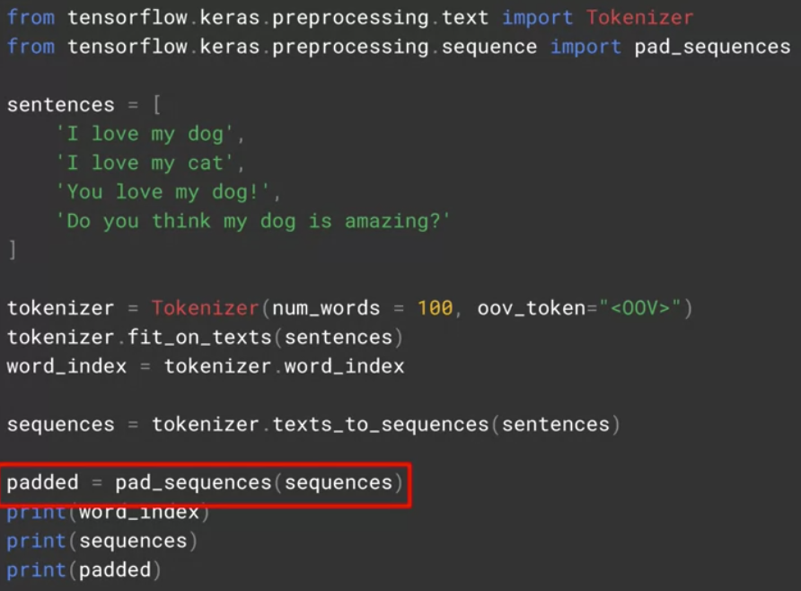
Padding in TensorFlow
When the tokenizer has created the sequences, these sequences can be passed to pad sequences in order to have them padded
The Padding in TensorFlow
8
Notes:
8

Slide 9
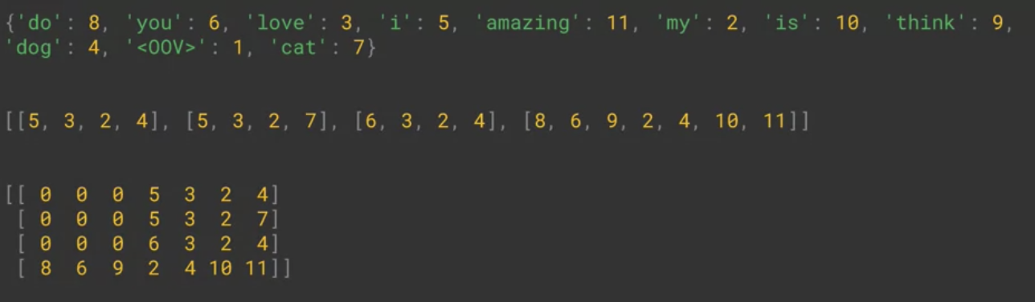
Padding in TensorFlow
The result
The Padding in TensorFlow
9
Notes:
9

Slide 10
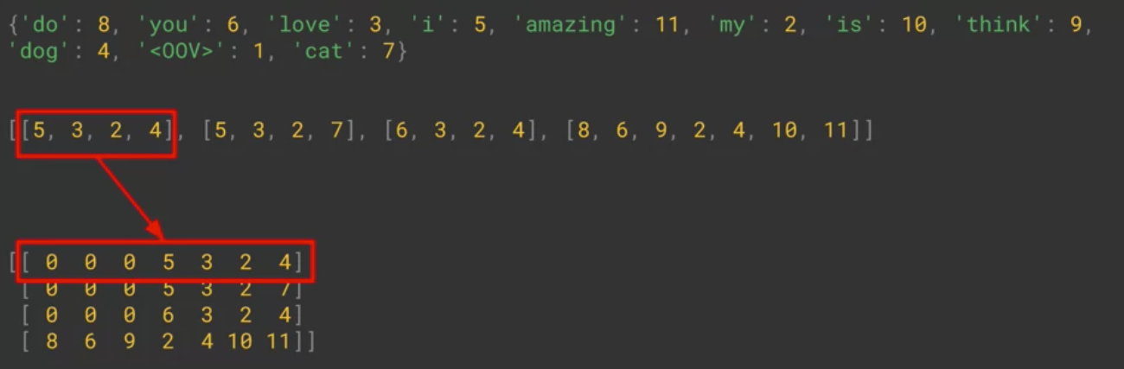
Padding in TensorFlow
The list of sentences has been padded out into a matrix and that each row in the matrix has the same length.
It achieved this by putting the appropriate number of zeros before the sentence.
The Padding in TensorFlow
10
Notes:
10

Slide 11
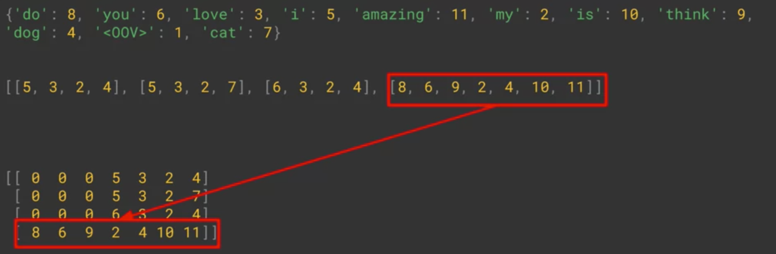
Padding in TensorFlow
In the case of the longer sentence here it didn't need to do any
The Padding in TensorFlow
11
Notes:
11

Slide 12
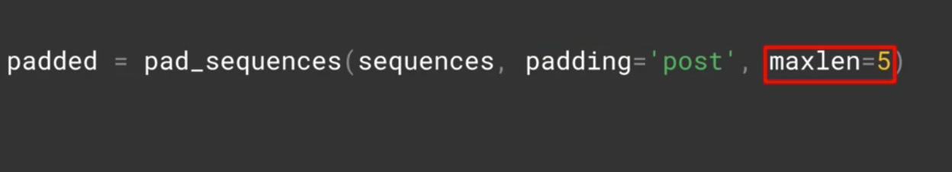
Padding in TensorFlow
We can change to add parameters
Adding the parameter padding equals post.
The maxlen parameter: (the matrix width was the same as the longest sentence)
Discuss: what the mean of that code?
The Padding in TensorFlow
12
Notes:
12

Slide 13
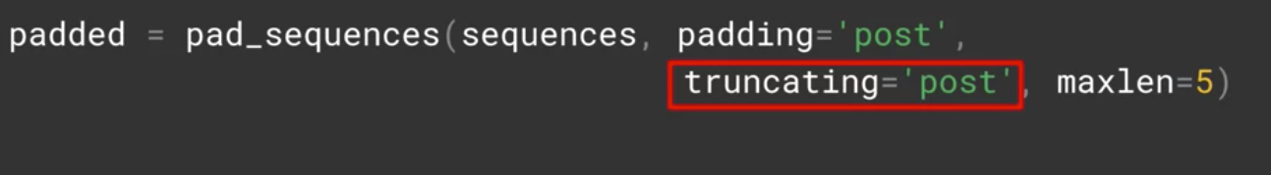
Padding in TensorFlow
If I have sentences longer than the maxlength, then I'll lose information but from where ?
The padding the default is ‘pre’, which means that you will lose from the beginning of the sentence.
If you want to override this so that you lose from the end instead, you can do so with the truncating parameter
The Padding in TensorFlow
13
Notes:
13

Slide 14
Summary
Overview of Padding in TensorFlow
Implement Padding in TensorFlow
The Padding in TensorFlow
14

Slide 15
Q & A
The Padding in TensorFlow
15

